Slide 1
Mini Project Data Engineering Study Case: Northwind Traders Database
by Adrian Maulana Muhammad
https://github.com/adrn-mm/DSLS_Mini-Project-DE_Adrian-Maulana-Muhammad

Slide 2
Table of Contents
Business Understanding
Analysis Objectives
Data Processing Flowcharts
Data Processing Queries
Data Analysis
Summaries & Recommendations
References

Slide 3
Business Understanding
I

Slide 4

Northwind Traders
Northwind Traders is a fictional company that operates as a wholesale supplier of food and non-food products. The database represents a typical business operating in the retail industry, which includes a wide range of products, customers, orders, and employees.

Slide 5
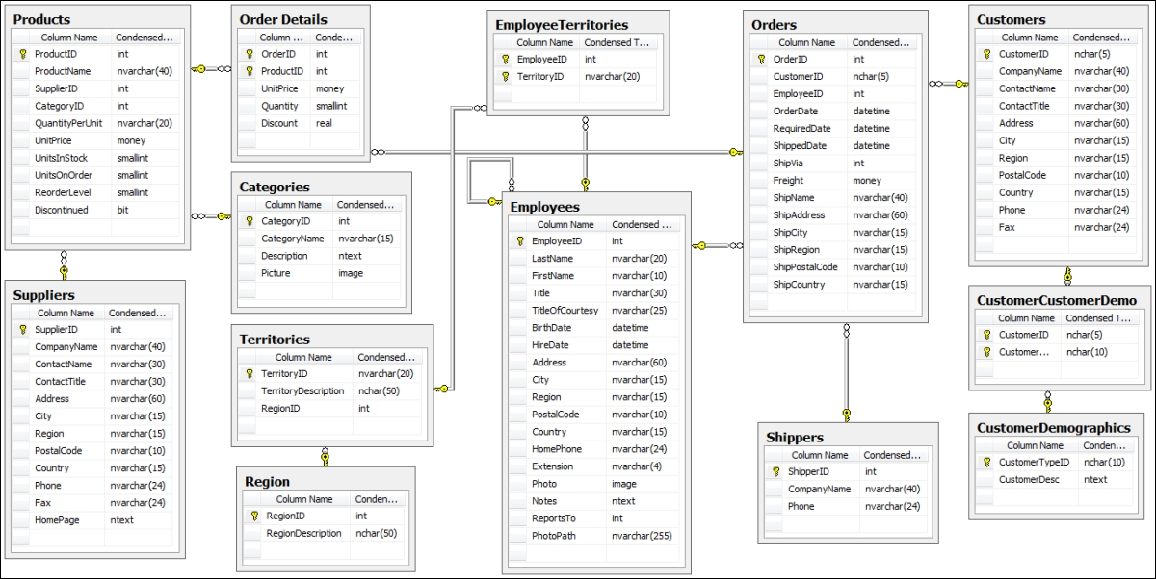
Northwind Traders Database Schema

Slide 6
Analysis Objectives
II

Slide 7
Analysis Scope & Goals
Scope | Goals
Product Analysis | Category of Items Sold The Most
 | The Best-Selling Products
Customer Analysis | Customer Spending by Country
 | The Most Frequent Customers by Number of Orders
Shipper Analysis | Average Delivery Time per Shipper
 | The Busiest Shippers

Slide 8
Product Analysis
Analysis of Category of Items Sold The Most
Use join to combine the data from the "Products", "OrderDetails“, and "Categories" tables.
Use aggregation to group the joined data by category and calculate the sum of quantity sold and total revenue for each category.
Use filtering to display only categories that have sold units above the average.
Analysis of The Best-Selling Products
Join the Orders and Order Details tables to retrieve order details information.
Filter the order details information to retrieve only the needed information.
Group the data by product ID and aggregate the data to find the total quantity of each product sold.
Sort the data in descending order to find the best-selling product.
Join the Products table to retrieve the product name.
Select the product name and total quantity to display the best-selling product information.

Slide 9
Customer Analysis
Analysis of Customer Spending by Country
Use join to combine the data from the "Customers" and "Orders Details" tables.
Use aggregation to group the joined data by country and calculate the sum of total revenue for each country.
Use filtering to display only countries where customer spending is above the average.
Analysis of The Most Frequent Customers by Number of Orders
Use CTE to create a subquery that counts the number of orders per customer.
Use filtering to display only customers with more than average orders.
Use sorting to order the data by the number of orders per customer and display the top 10 most frequent customers.

Slide 10
Shipper Analysis
Analysis of Average Delivery Time per Shipper
Use join to combine the data from the "Orders" and "Shippers" tables.
Use condition to calculate the difference between the "ShippedDate" and "OrderDate" columns.
Use aggregation to group the joined data by shipper and calculate the average delivery time for each shipper.
Analysis of The Busiest Shippers
Use join to combine the data from the "Orders" and "Shippers" tables.
Use aggregation to count the number of orders shipped by each shipper.
Use sorting to order the data by the number of shipped orders and display the top 10 busiest shippers.

Slide 11
Data Processing Flowcharts
III

Slide 12
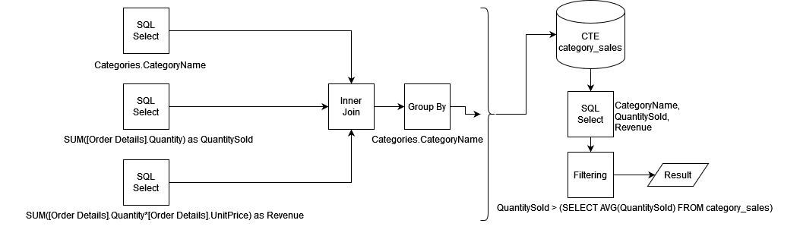
Product Analysis Flowcharts
Flowchart of Analysis of Category of Items Sold The Most

Slide 13
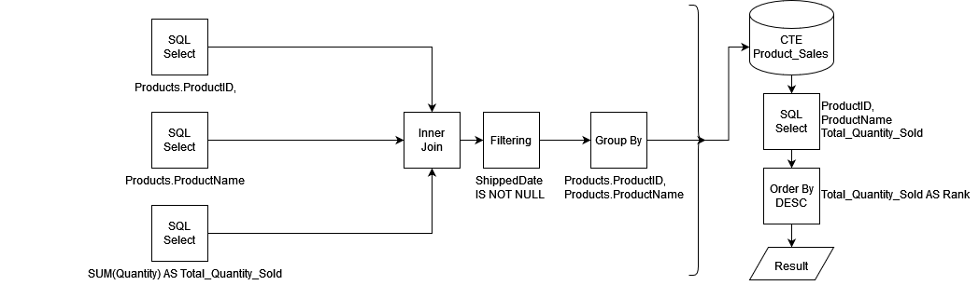
Product Analysis Flowcharts
Flowchart of Analysis of The Best-Selling Products

Slide 14
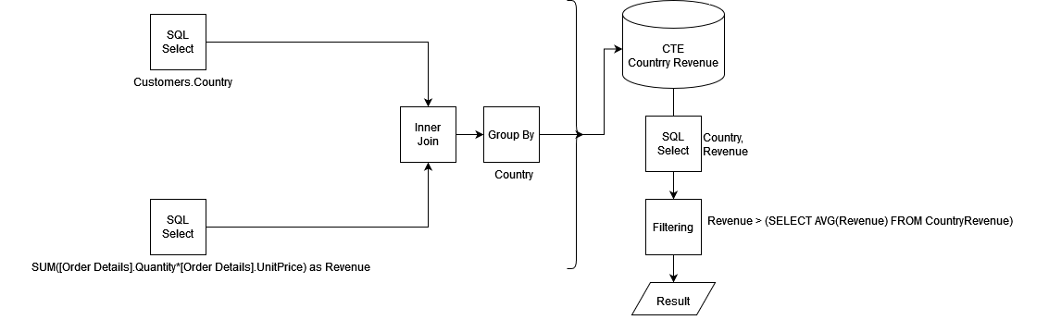
Customer Analysis Flowcharts
Flowchart of Analysis of Customer Spending by Country

Slide 15
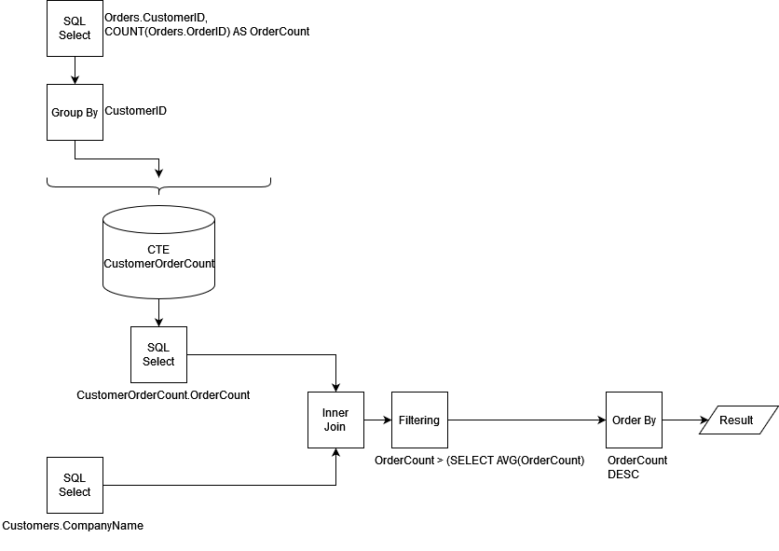
Customer Analysis Flowcharts
Flowchart of Analysis of The Most Frequent Customers by Number of Orders

Slide 16
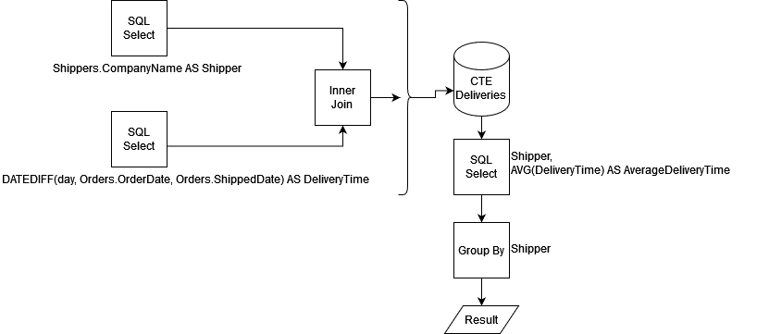
Shipper Analysis Flowcharts
Flowchart of Analysis of Average Delivery Time per Shipper

Slide 17
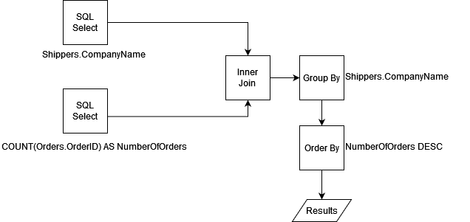
Shipper Analysis Flowcharts
Flowchart of Analysis of The Busiest Shippers

Slide 18
Data Processing Queries
IV

Slide 19
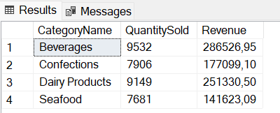
Product Analysis Queries
Query of Analysis of Category of Items Sold The Most
WITH category_sales AS (
SELECT
Categories.CategoryName,
SUM([Order Details].Quantity) as QuantitySold,
SUM([Order Details].Quantity*[Order Details].UnitPrice) as Revenue
FROM
Products
JOIN
[Order Details] ON Products.ProductID = [Order Details].ProductID
JOIN
Categories ON Products.CategoryID = Categories.CategoryID
GROUP BY
Categories.CategoryName
)
SELECT
CategoryName,
QuantitySold,
Revenue
FROM
category_sales
WHERE
QuantitySold > (SELECT AVG(QuantitySold) FROM category_sales)

Slide 20
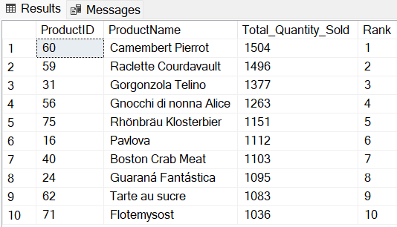
Product Analysis Queries
Query of Analysis of The Best-Selling Products
WITH Product_Sales AS (
SELECT
Products.ProductID, Products.ProductName,
SUM(Quantity) AS Total_Quantity_Sold
FROM
Orders
INNER JOIN
[Order Details] ON Orders.OrderID = [Order Details].OrderID
INNER JOIN
Products ON [Order Details].ProductID = Products.ProductID
WHERE
ShippedDate IS NOT NULL
GROUP BY
Products.ProductID, Products.ProductName
)
SELECT TOP 10
ProductID,
ProductName,
Total_Quantity_Sold,
ROW_NUMBER() OVER (ORDER BY Total_Quantity_Sold DESC) AS Rank
FROM
Product_Sales

Slide 21
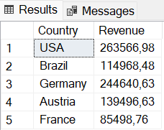
Customer Analysis Queries
Query of Analysis of Customer Spending by Country
WITH CountryRevenue AS(
SELECT
Customers.Country,
SUM([Order Details].Quantity*[Order Details].UnitPrice) as Revenue
FROM Customers
JOIN Orders ON Customers.CustomerID = Orders.CustomerID
JOIN [Order Details] ON [Order Details].OrderID = Orders.OrderID
GROUP BY Country)
SELECT * FROM CountryRevenue
WHERE Revenue > (SELECT AVG(Revenue) FROM CountryRevenue)

Slide 22
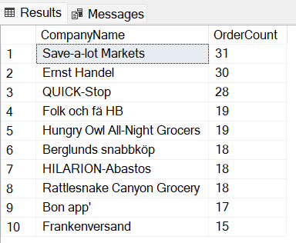
Customer Analysis Queries
Query of Analysis of The Most Frequent Customers by Number of Orders
WITH CustomerOrderCount AS (
SELECT
CustomerID,
COUNT(OrderID) AS OrderCount
FROM Orders
GROUP BY CustomerID
)
SELECT TOP 10
Customers.CompanyName,
CustomerOrderCount.OrderCount
FROM Customers
JOIN CustomerOrderCount ON Customers.CustomerID = CustomerOrderCount.CustomerID
WHERE
CustomerOrderCount.OrderCount > (SELECT AVG(OrderCount) FROM CustomerOrderCount)
ORDER BY
CustomerOrderCount.OrderCount DESC

Slide 23
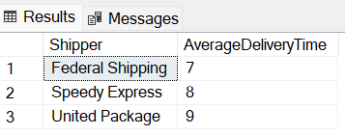
Shipper Analysis Queries
Query of Analysis of Average Delivery Time per Shipper
WITH deliveries AS (
SELECT
Shippers.CompanyName AS Shipper,
DATEDIFF(day, Orders.OrderDate, Orders.ShippedDate) AS DeliveryTime
FROM Orders
JOIN Shippers ON Orders.ShipVia = Shippers.ShipperID
)
SELECT
Shipper,
AVG(DeliveryTime) AS AverageDeliveryTime
FROM deliveries
GROUP BY Shipper

Slide 24
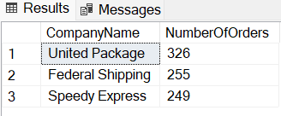
Shipper Analysis Queries
Query of Analysis of The Busiest Shippers
SELECT
Shippers.CompanyName,
COUNT(Orders.OrderID) AS NumberOfOrders
FROM
Orders
INNER JOIN Shippers
ON Orders.ShipVia = Shippers.ShipperID
GROUP BY
Shippers.CompanyName
ORDER BY
NumberOfOrders DESC

Slide 25
Data Analysis
V

Slide 26
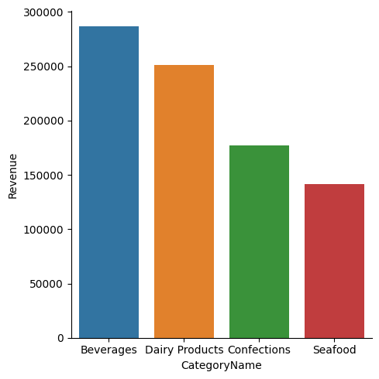
What Category of Items Sold The Most?
Based on the data visualization, it is evident that the product category that generated the highest revenue and sold the most units is Beverages, while the category with the lowest revenue is Seafood. The findings are aligned with the analysis of the Northwind database and provide valuable insights into the market performance of different product categories.

Slide 27
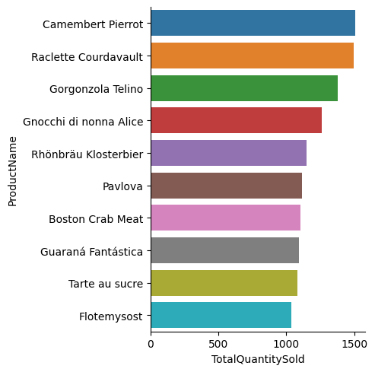
What is The Best-Selling Product?
Based on the data visualization displayed alongside, it is evident that the most highly sold product is Camembert Pierrot. Further analysis of the sales figures for this product indicates that it has consistently been one of the top-performing products within the Northwind inventory.

Slide 28
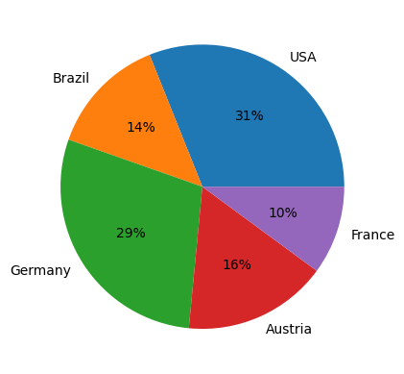
From Which Country Do The Customers Originate?
Based on the visualization data displayed, it is evident that most customers are located in the United States, while the few are from France. This can provide valuable insights into the geographical distribution of the customer base and can be used to inform future business strategies and marketing efforts.

Slide 29
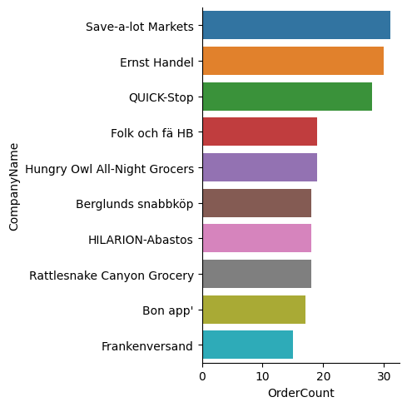
Which Company Places The Most Orders?
Based on the visualization data shown, it can be seen that the company that places the most orders is Save-a-lot Markets, and the company that places the least orders is Franken versand. The insights gleaned from this analysis indicate the purchasing patterns of different companies and could provide valuable information for businesses looking to optimize their sales and marketing strategies.

Slide 30
Summaries & Recommendations
VI

Slide 31
Based on the above data analysis, the following conclusions can be drawn
From the above facts, it can be concluded that the Beverages product category is the most profitable and highly sold in the Northwind database. This information can inform product development and inventory management strategies by prioritizing the production of similar products or expanding the Beverages category.
Furthermore, the high sales performance of Camembert Pierrot highlights the potential for similar products to perform well in the market. This could inform product development and marketing efforts for similar products.
The majority of customers are located in the United States, which suggests that there may be potential for further growth in this market. Marketing and sales efforts could be focused on this region to target potential customers and increase sales.
Save-a-lot Markets place the most orders, suggesting they may be a valuable target for business-to-business sales and marketing efforts. On the other hand, the low number of orders placed by Frankenversand highlights the potential for further growth in this market and the opportunity to target this company for increased sales.

Slide 32
References
VII

Slide 33
https://github.com/yugabyte/yugabyte-db/wiki/Northwind-Sample-Database
https://medium.com/analytics-and-data/the-path-to-learning-sql-and-mastering-it-to-become-a-data-engineer-256ea0fef4e7
https://www.mssqltips.com/sqlservertip/6921/data-engineering-solution-python-sql-server/

Slide 34
Thank You!

